Slide 1

EXL Analytics
Collection and Recovery Strategy Knowledge Sharing
June 2018

Slide 2
1. Overview of Collection Strategies

Slide 3
Collections and recoveries is a non-linear process, each stage having separate objective
Collections and Recoveries process
Early Stage
(<90 DPD)
Contact and cure
0. Pre
Delinquent
Stage
2. Late Stage
(90-180 DPD)
Mitigate Losses
3. Charge-off
(>180 DPD)
Outsource, sue, sell

Slide 4



EXL helps to achieve results across the entire lifecycle of collections by applying appropriate strategies
Early Stage | Late Stage | Charge-off
Segmentation Strategy
Combine quantitative information (e.g. risk, balance) with qualitative information (e.g. contact history) to drive prioritization of collection effort
Recovery Strategy
Contact Strategy
Litigation letter strategy
Optimize letter verbiage and letter delivery vendor
Optimize timing, frequency and medium of contacts
Agent assignment based on granular segments
Identify and design alternate early stage strategy for skip accounts with high likelihood of getting traced later
Optimize across debt Sale vs external vs internal efforts based on collectability
Dynamic agency pricing based on the performance, compliance and customer experience
Identify accounts that should go to litigation based on customer asset size, laws of the state
Debt-Restructuring Strategy
Optimize forbearance and re-age program by running experiments
Propose best settlement offer that will have high likelihood of acceptance
Process control strategy
Fix collection process exceptions, align process with policy

Slide 5
We do strategy design, experimenting, and reporting to build new strategies and to optimize the existing ones
Test vs control split
Strategy implementation on test population
Strategy Design
Experimenting
Hypothesis creation
Exploratory data analysis
Modelling
Collection Strategy Optimization Process
Reporting & Recommendation
Report strategy performance
Statistical test to compare test vs control
Recommendation

Slide 6
2. Selected Work in the past 12 months

Slide 7

Segmentation Strategy
Early Stage Segmentation
Late Stage Segmentation
Vijender+ Raghav
Model Improvement
1
Situation:…….
Initiative:……..
Impact: …
1
Situation:…….
Initiative:……..
Impact: …
2
Situation:…….
Initiative:……..
Impact: …
2
Situation:…….
Initiative:……..
Impact: …
Model Maintenance
1
…
Result: …
1
…
Result: …
2
…
Result: …
2
…
Result: …
3
…
Result: …
3
…
Result: …

Slide 8
Contact Strategy
 | Early Stage |  |  | Late Stage
 | Bucket 1 | Bucket 2 | Bucket 3 | Bucket 4 | Bucket 5 | Bucket 6
Email
Text
Auto Agent (Outbound IVR)
Live Agent
Letter (Lifecycle)
Letter (specialty)
Pranjal + Ashutosh
Hypothesis:…….
Initiative:……..
Hypothesis :…….
Initiative:……..
Hypothesis :…….
Initiative:……..
Hypothesis :…….
Initiative:……..
Hypothesis :…….
Initiative:……..
Hypothesis :…….
Initiative:……..
Hypothesis :…….
Initiative:……..

Slide 9



Debt-restructuring Strategy
Vinay
Forebearance
Re-age
Settlement
Strategy Initiatives
1
Initiative :…….
Impact:……..
3
Initiative :…….
Impact:……..
4
Initiative :…….
Impact:……..
2
Initiative :…….
Impact:……..
MIS
1
…
Result: …

Slide 10


Recovery Strategy
Ruchira + Sahil
3rd Party Collection Agency
Litigation
Strategy Initiatives
1
Initiative :…….
Impact:……..
3
Initiative :…….
Impact:……..
2
Initiative :…….
Impact:……..
MIS
1
…
Result: …

Slide 11
Process Control
1
…
2
…
3
…
Problem
…
Solution
…
Difficulty
….
Solution
….
Difficulty
…
Solution
…
Rakesh+ Shubham
4
…
5
…
6
…
Difficulty
…
Solution
…
Difficulty
…
Solution
…
Difficulty
…
Solution
…

Slide 12
3. Case-Studies

Slide 13
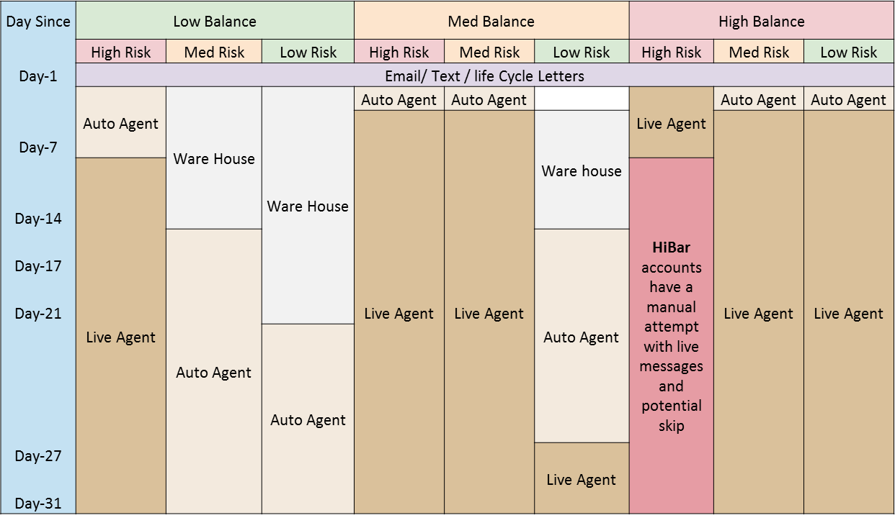

Segmentation Strategy: Case of building an effective segmentation model for applying downstream strategies
Point of departure
Old segmentation became irrelevant due to significant population shift resulting in misclassification of accounts
There were rank order breaks in flow rate, loss rate based on old segmentation
Approach
3. Experimented with multiple segmentation models
5. Used the model to redesign contact strategy
Dialer
AVR
Letter
Text
Email
1. Prepared attributes for segmentation
Collection attributes
Bureau information
Personal information
Inbound call information
Transaction information
Internal scores
2. Variable selection was based on dual target framework
Charge-off
Self cure
Model with best separation power
4. Selected the model that had best separation power
Point of arrival
For the same NCL save, new segmentation reduced
Annual operational expenses by $1.3 M
FTE requirement by 30

Slide 14


Contact Strategy: Case of establishing contact with delinquent customers who could not be contacted via phone
Point of departure
Delinquent population with whom no dialer contact could be generated was showing very low payment rate and very high roll forward rate
There was a need to make alternate channels of contact (especially letter) more effective
Approach
1. Hypothesis building
2. Running experiment and reporting outcome
3. Recommendation
An experiment was created where 50% population was sent letters via USPS and rest 50% were sent letters via UPS
Letter contact needs to be effective for no dialer contact customers
Hypothesis: Improved letter delivery can help in re-establishing contact with no dialer contact customers
Hire UPS, payment rate better by 128 BPS
Bucket 1
New courier vendor to test
Bucket 2
Continue testing
Skip
Letter
Delivery | Mailbox | Door step
Delivery time | 7 days | 3 days
Delivery method | Regular envelope | Special / Larger envelope
Bucket 3
Revert to USPS
UPS
Letter
Settlement Letter
Bucket 4
Continue testing
Bucket 5 & 6
Hire UPS, payment rate better by 214 BPS
UPS was found to be effective in Bucket 1, 5 and 6
Point of arrival
Projected GCL save of ~3M

Slide 15
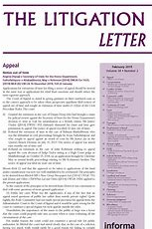


Recovery Strategy: Case of recovery from delinquent customers against whom bank had won litigation but still had un-cleared dues
Point of departure
Large proportion of delinquent customers who had lost litigation against the bank and were obliged to pay their due amount, were not paying
Bank had to initiate recovery from these customers but also not incur high cost
Approach
1. Identify population segment where extra recovery effort will yield favorable outcome
3. Strategy delivery
3.1 Sent litigation letter through 3rd party attorneys with one time settlement offer
Active Payers
(12%)
Dormant Payers
(22%)
2. Target population segment identified
High Balance + belong to business friendly states
3.2 Timed the letter during Q1 to take advantage of tax season
Delinquent customers who lost case 3 years back
(100%)
3.3 Continuously monitored strategy
Non-Payers
(66%)
Other Dormant and Non-payers
Point of arrival
~ 1M additional payment received due to the strategy and the strategy is still ongoing. Potential save is ~3M in the current year

Slide 16
Recovery Strategy: Case of comparing performance of specialized debt settlement agencies (DSA) vs BAU agencies
Point of departure
To understand if specialized Debt Settlement Agencies (DSA) are more effective in collecting money than BAU agencies
Approach
Delinquent population eligible for agency placement
Delinquent accounts scrubbed , 80% sent to BAU and 20% sent to DSA agency
Placed with BAU Agency
(80%)
Placed with DSA Agency
(20%)
Net liquidation rate was tracked for both early out and charge-off population
Early Out*
Charge-off
Early out*
Charge-off
2.17%
1.85%
4.42%
2.69%
Paired t-test used to compare liquidation rate
As per, t-test DSA agencies had higher liquidation rate than BAU agencies
Point of arrival
Recommended rollout of DSA treatment to 100% Early Out & Post Charge Off agency DSA scrub population
It is expected that the rollout will translate NCL save of ~0.5-1M annually
*Early-outs are customers who are delinquent beyond 90 days, have very high risk scores and high balance

Slide 17
Process Control Strategy: Case of simplifying bankruptcy linked charge-off process
Point of departure
Accounts who had filed for bankruptcy were getting charged-off immediately but when their bankruptcy petition was dismissed their charge-off was getting reversed. This was complicating the collection effort
Approach
Simplified Process for accounts who filed for Bankruptcy
Process kept as is
Old process that was removed
New process added
Customer remains in charged-off state
Bankruptcy appeal approved
Customer initiates bankruptcy
Credit card company charges-off customer by 1 month
Court decision on bankruptcy
Charge-off reversal happens
Charge-off happens contractually
Bankruptcy appeal dismissed / bankruptcy reversal
Customer remains in charged-off state. Charge-off reversal happens only when bankruptcy was initiated due to bank error
Reason: It was observed that 85% accounts for whose bankruptcy appeal was dismissed were anyways getting charged-off contractually. So reversal does not make sense
Point of arrival
Re-purposed “write-off indicator” in database to identify cases of bankruptcy reversal and updated rules to ensure that those account should not undergo charge-off reversal

Slide 18

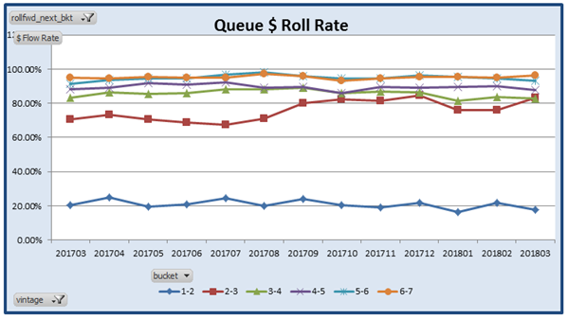
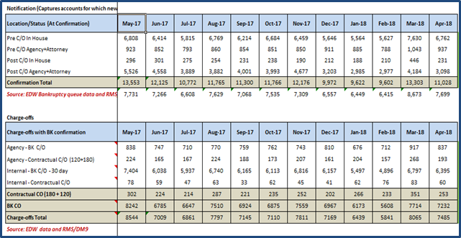
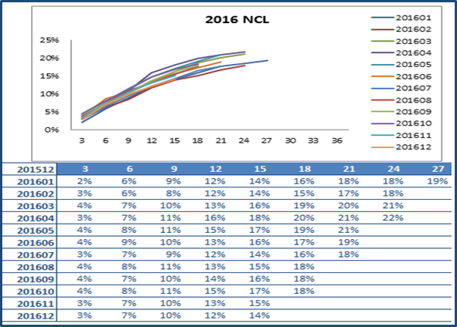
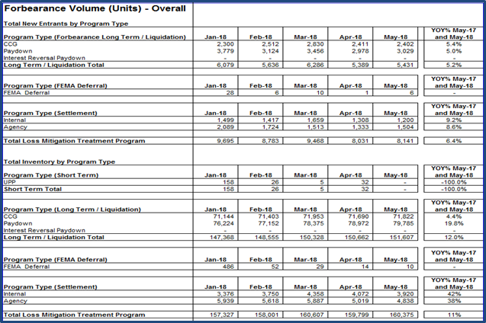
Reporting: Generating high visibility periodic and ad hoc reports
Intuitive Dashboard
Automated Scripts
Leadership Visibility
Ad hoc reports
Bucket Roll Forward Rate
Bankruptcy Dashboard
Forbearance NCL and Break rates
Forbearance Volume (New Entrants)

Slide 19
4. Journey of Collections Strategy

Slide 20
Manish can you help me with this slide?

Slide 21
4. Opportunity Map

Slide 22
Segmentation
Segmentation based on risk and balance dimension
Add contactability dimension:
In-house collection for high contactability
3rd party for low contactability
Consolidate risk, balance and contactability into “ability to pay” and “willingness to pay”
Contact
Each segment has their own contact queue
Constant contact frequency and timing for each queue
Skill based assignment of collection agents
Contact frequency (3 vs 4 / day) optimized for each channel
Contact timing (e.g. w’day vs w’end) optimized for each channel
Forbearance
Settlement
Recovery: 3rd Party Collection Agencies
Recovery: Litigation
Already
exists in large retail banks
EXL can help
LEGEND:

